Slide 1

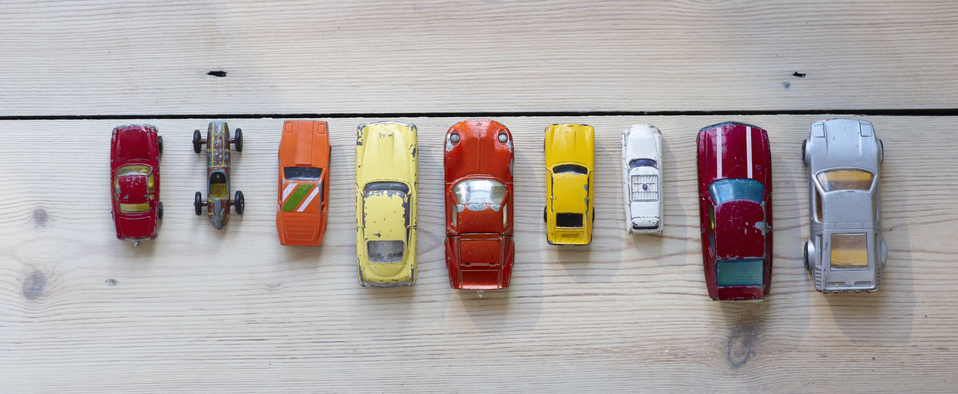




Fuel Consumption of Different Car Models
Zaid Al-Jawadi

Slide 2
A non-technical overview of the subject area and the problem statement/opportunity identified
Investigate fuel consumption across different car brands and models
Identify the relationship between different car features and fuel consumption and carbon emissions (g/km)
Assess how technology has evolved from 1995 to 2023 regarding fuel efficiency
Predict fuel consumption based on car features

Slide 3
An overview of proposed vision for tackling the problem using Data Science
Data collection
Data preprocessing/cleaning
Exploratory data analysis (EDA)
Feature engineering
Model selection, training, and validation
Demand forecasting

Slide 4
An estimate of the potential impact of such a solution
Showcase the differences in fuel consumption between different car makes, models, and other features
Show how fuel efficiency has changed over time
Predicting fuel consumption and CO₂ emissions based on car features and driving conditions/patterns

Slide 5
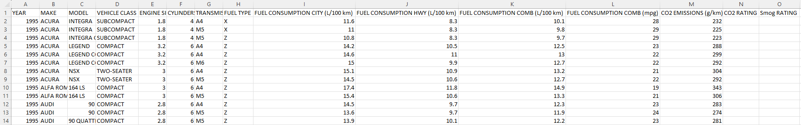
An introduction to the dataset, including data quality concerns and findings from preliminary EDA
Data was obtained from Government of Canada (Natural Resources Canada)
Compilation of fuel consumption of all car models in Canada from 1995 – 2023
Data quality: Most columns are clean with no missing values or duplicates
Two metrics, CO₂ RATING and SMOG RATING, started being tracked in 2016 and 2017, respectively
If possible, values for previous years could be deduced; otherwise, the columns will be deleted

Slide 6
Next steps in terms of data processing, feature engineering and baseline modeling
Models will be explored to identify relationships between different car features and fuel consumption
Car year and make
Vehicle class
Transmission
Engine size
Fuel type
Identify relationship between fuel type and CO₂ emissions
Predict fuel consumption based on features such as year of car make, brand, and model

